Slide 1
Metallicity Variations in Globular Clusters Milone et al. 2013 – “A WFC3/HST View of the Three Stellar Populations in the Globular Cluster NGC 6752”
Max Genecov | UC Berkeley | October 10, 2016

Slide 2
Goal:
To understand the quality of the variations in metallicity and elemental abundances in globular clusters.
Gradient? Modality? Radial dependence? etc.
Find different populations in main sequence, sub-giant, red-giant, and horizontal branches
Do they match up? Is there population continuity through mass?
Look at NGC 6752 in a bunch of HST bands and try to uncover the populations and associated element abundances

Slide 3
“It is a truth universally acknowledged…”
Metallicity variations within GCs have been known for a long time
Their sources are the unknown part
Correlations and anti-correlations between element abundances
Helium content can also vary between clusters
Multiple MSs and SGBs have been detected in other GCs
Variations in element abundance have already been observed, though not quantified, in NGC 6752

Slide 4
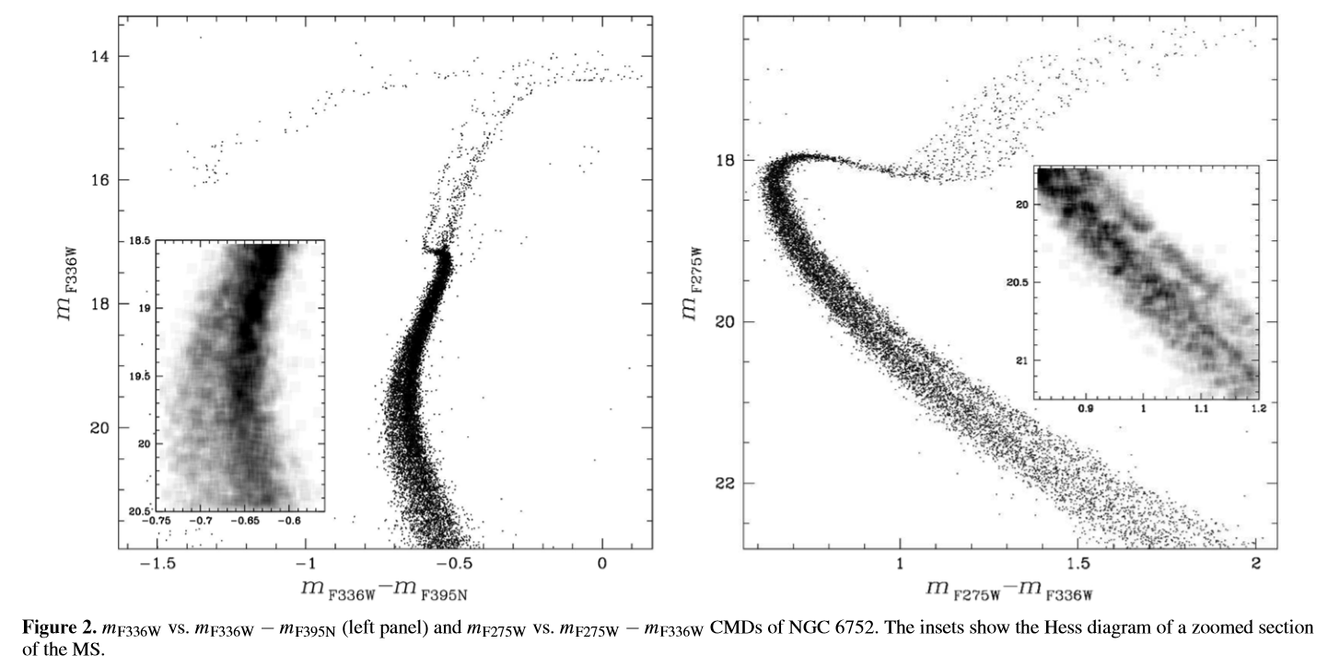



Simple CMDs Show Evidence of Multiple Populations
At this point, it’s just by eye, but it’s kind of convincing already.
Multiple populations at every age and type.

Slide 5
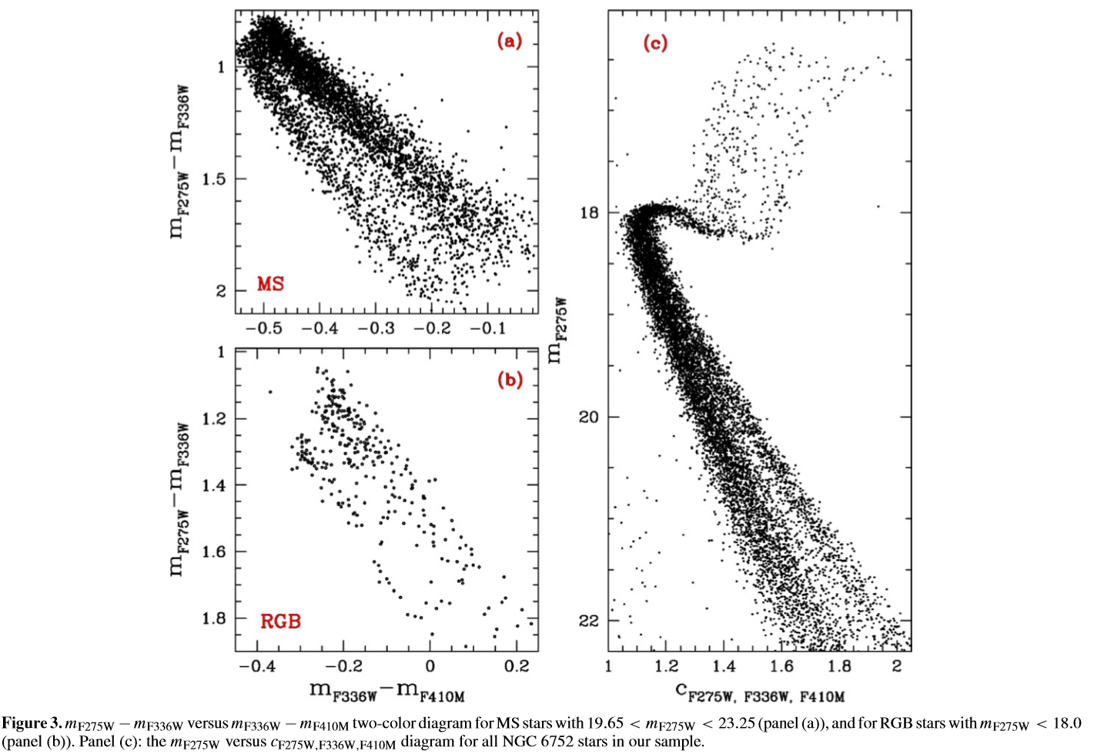

Simple CMDs Show Evidence of Multiple Populations

Slide 6
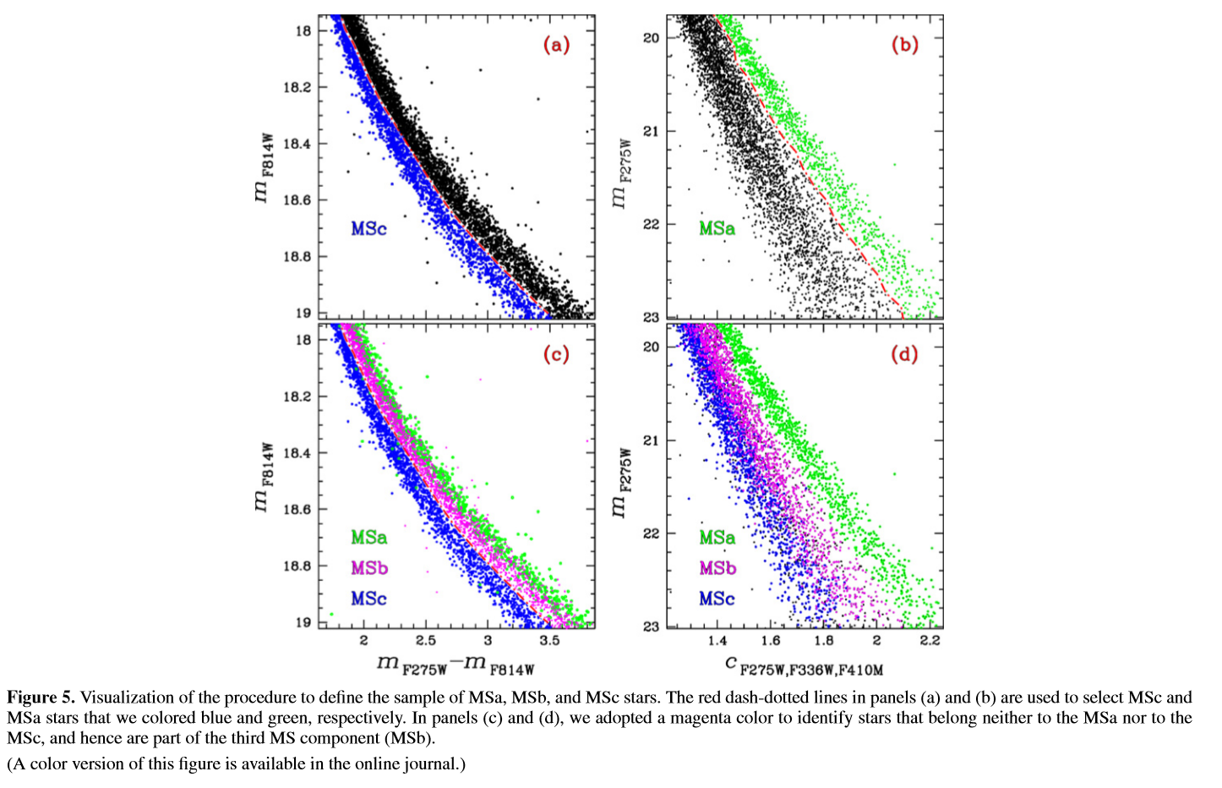
Multiple MS Populations
Helium differences can contribute to wide MS
Divided into three populations via histograms
25% MSa, 31% MSc, 44% MSb
But how do they change in different bands?

Slide 7
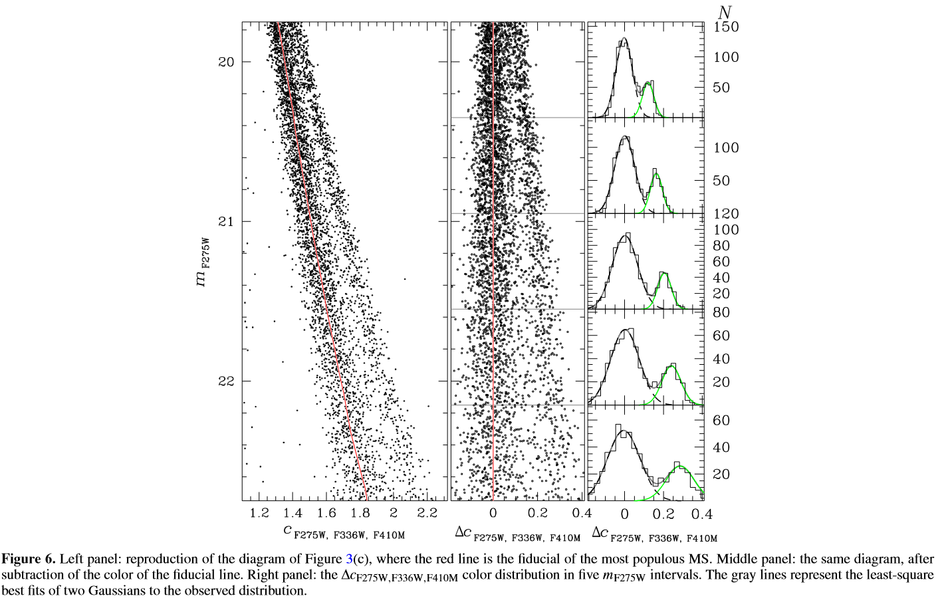
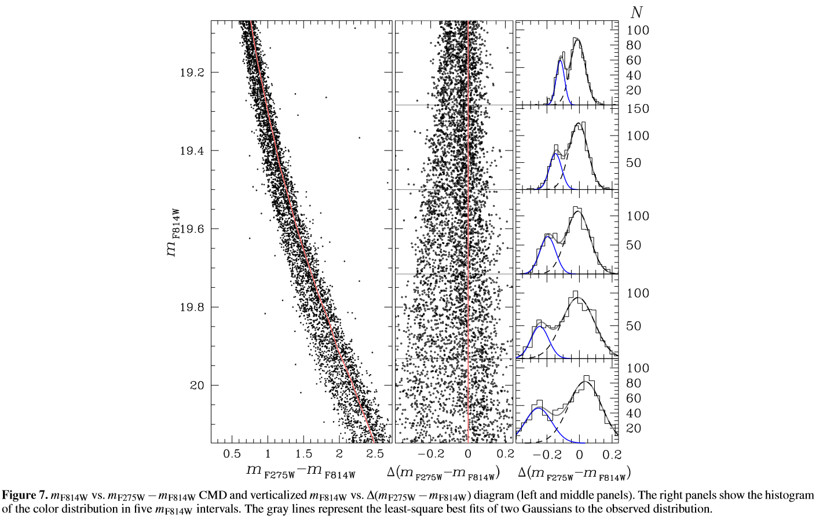
Multiple MS Populations

Slide 8
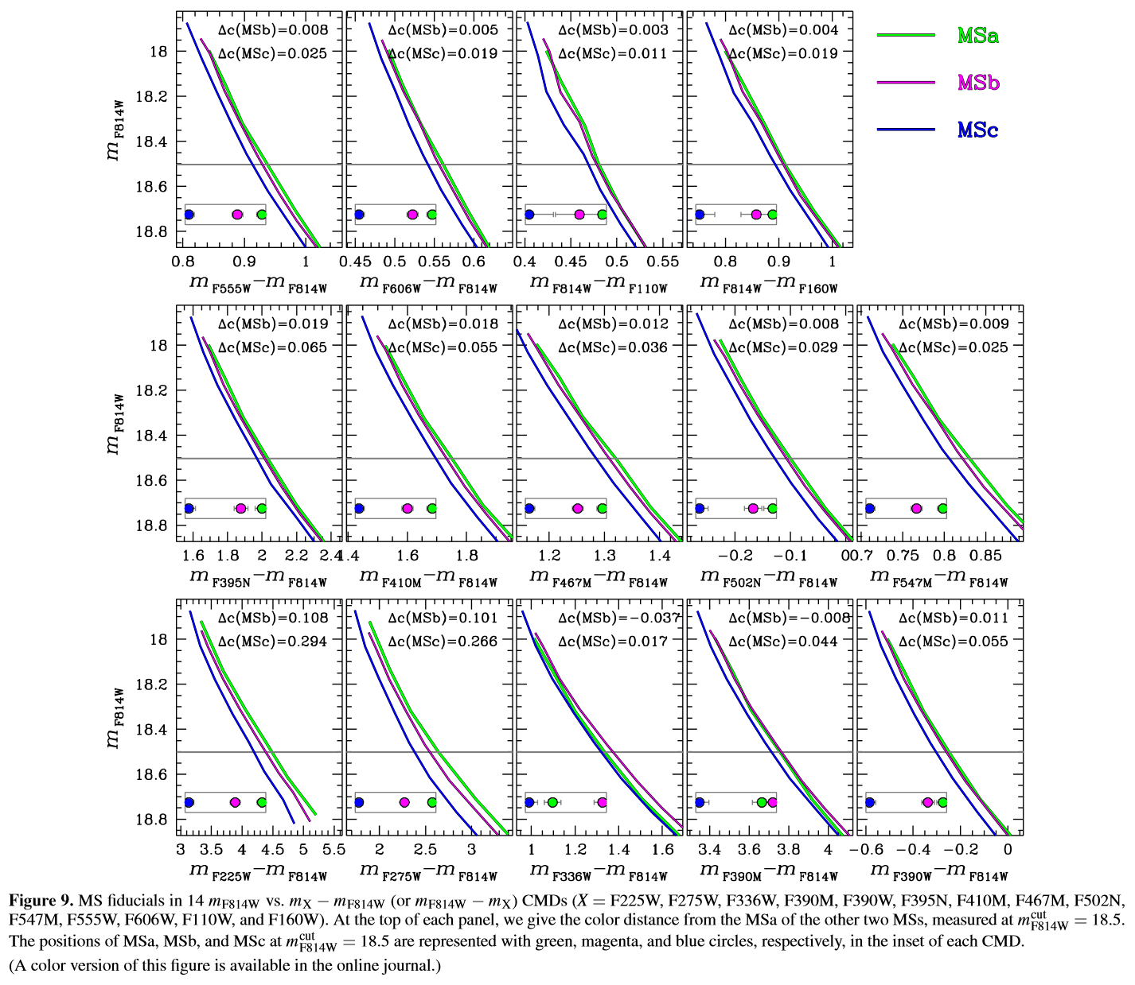
Multiple MS Populations
Fiducial lines shown (deviation derivation?)
MSa and MSb track each other very closely in most simple color comparisons, but not all!
Wider color baseline – wider separation between MSc and MSb

Slide 9
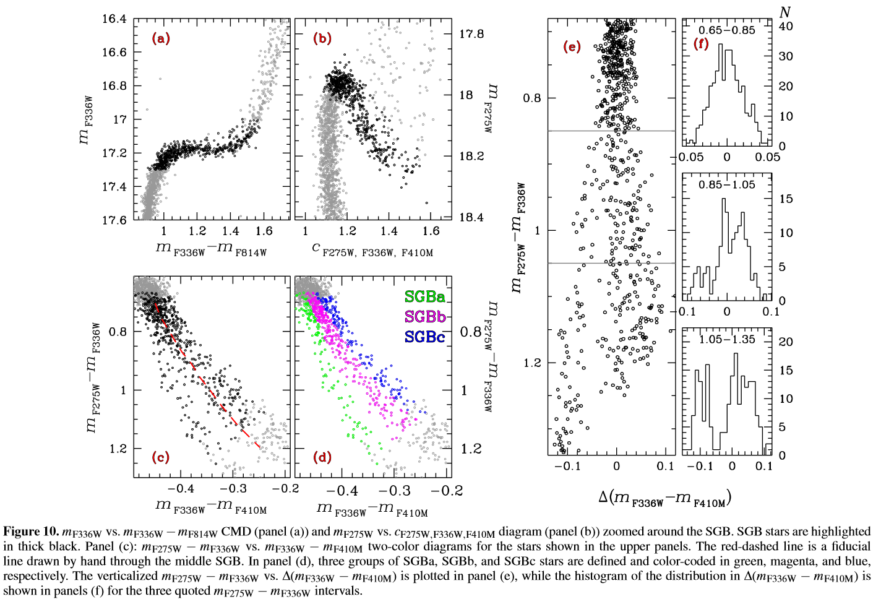
Multiple SGB Populations
Previous analysis found a spread in SGB in U magnitude with different concentrations.
This paper disagrees with that assessment, but still finds three populations “by eye.”
Do these populations realllllly match up with the MS populations?

Slide 10
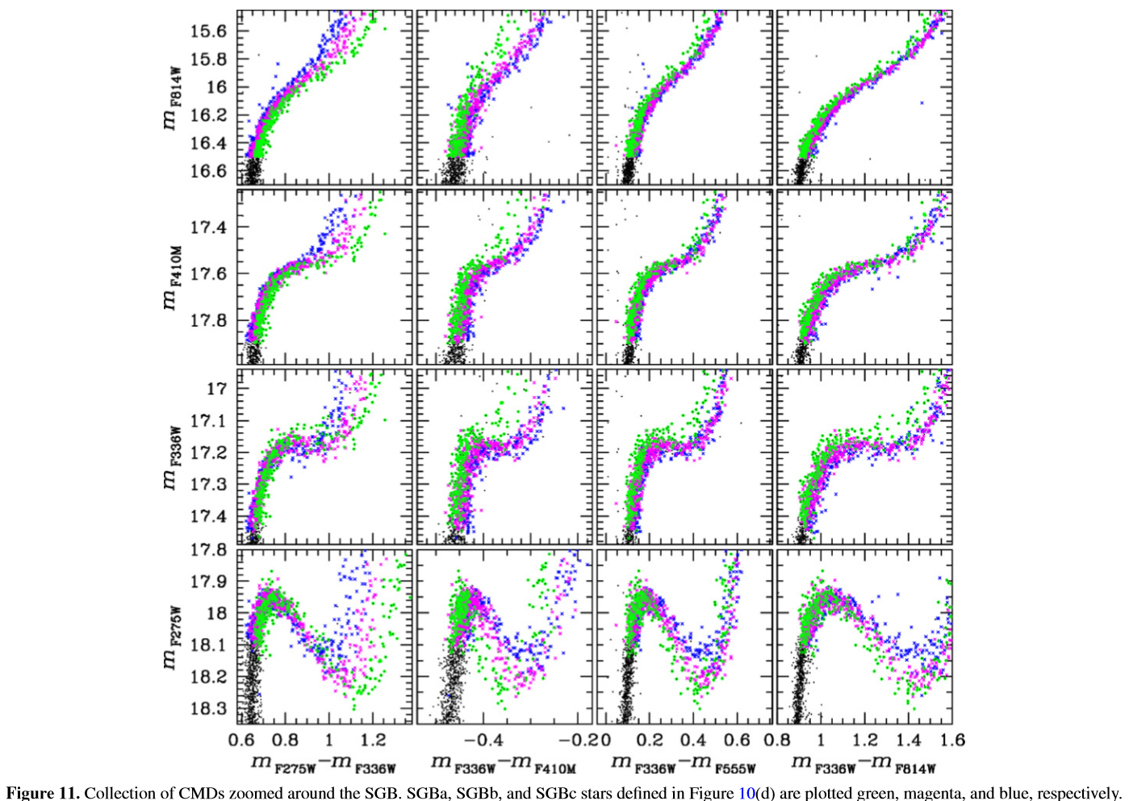
Multiple SGB Populations
SGBa stars look somewhat like the MSa stars
But that doesn’t mean we’ve found a match
What gives the authors the power to begin with the idea that these SGB populations correspond to the MS ones?

Slide 11
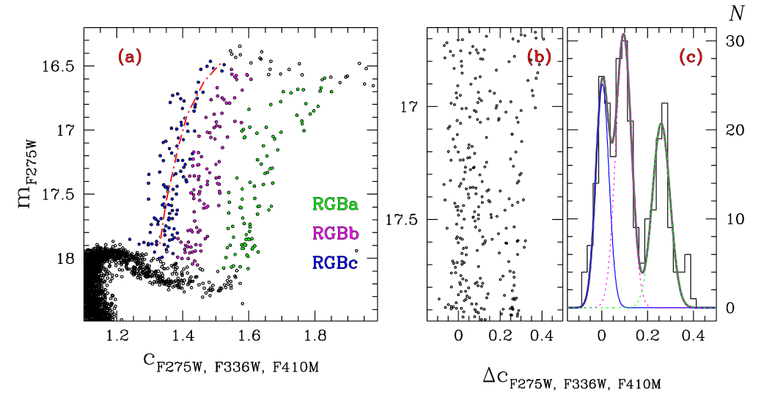
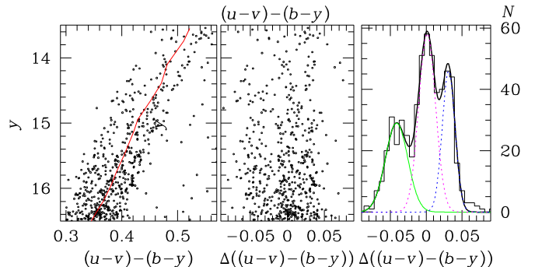
Multiple RGB Populations
Previous observations show a large spread in the Stromgren index
(c_y = ( u - v - b + y)
CMDs used earlier show three RGBs
Three populations separated again “by hand”
Proven later in the paper to follow certain color relations
Small numbers of RGB stars make statistics difficult

Slide 12
Multiple RGB Populations
“All methods applied thus far to the MS and RGB yield very similar fractions of the a, b, and c populations, suggesting an association between the MS and RGB for the three populations.”
Here again, when trying to connect the populations from different initial masses to each other, there’s a bit of qualitative fudging.
Is there a better way to measure the change in ridge-line with color/metallicity to find these populations than separating them by eye and then making generalizations?

Slide 13
Modelling the Populations
If all these populations in different stellar lifetime phases are the same three populations, then we turn to what makes them different
Helium and light-element abundances
Taking note of established element correlations, make isochrones with different fits for the three populations
Option I: same chemical composition same different helium abundance
Option II: different chemical composition and same helium abundance
Option III: different chemical composition and helium abundance

Slide 14
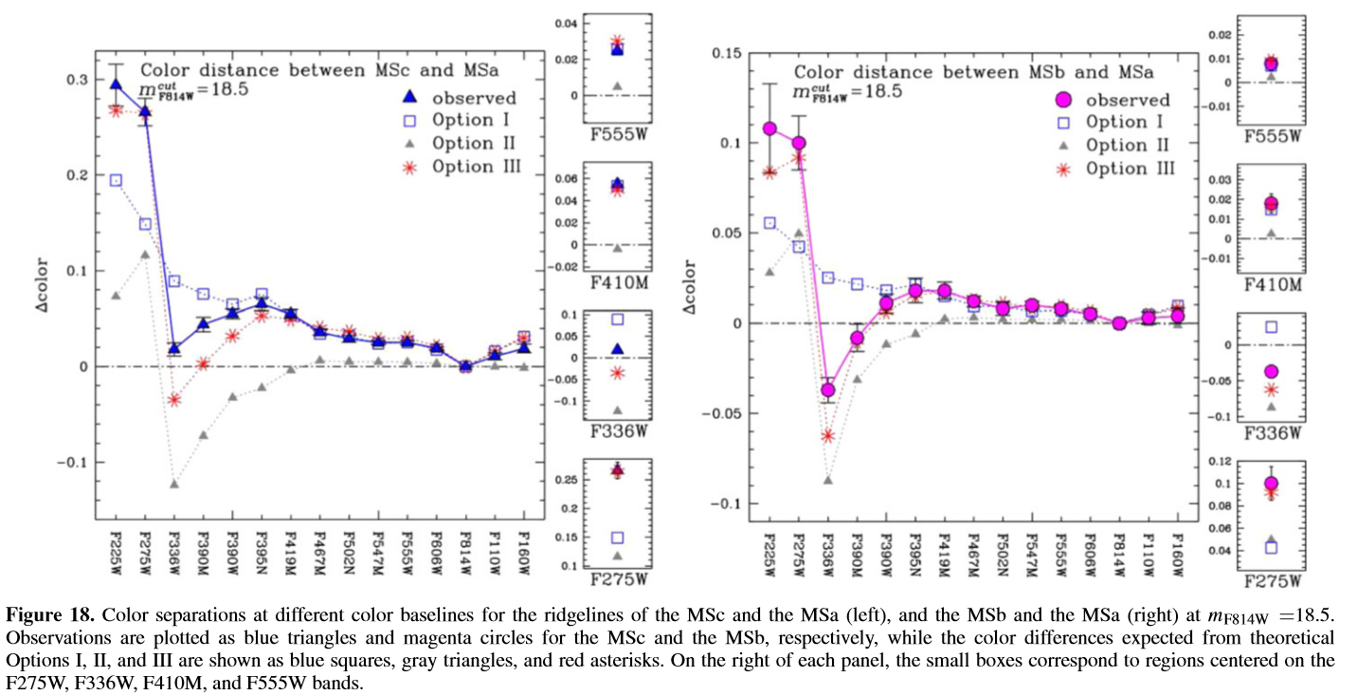
Modelling the Populations
Only Option III, varying both helium and chemical abundances, can account for the high difference in color between MSc and the other two populations on the blue end.

Slide 15
Modelling the Populations
Because Option III can pretty well model the actual differences in the MS and RGB populations, the authors can conclude that all the populations are continuous.
So why did they have this half-baked explanation for them in the first place?
There is also no radial difference in the relative abundance of the populations.

Slide 16
So what causes these populations?
The authors offer “the most straightforward explanation”
Pop a was the first stellar group born from the Galactic halo
Pop b and Pop c formed from the partially-processed material of large Pop a stars that enriched the environment
But what differentiates Pop b and Pop c other than helium abundance? No answer in the paper!
There is still an intrinsic spread within each group
Similar explanations have been made for other GCs.

